Slide 1


C PROGRAMMING FOR PROBLEM SOLVING
(25EN1114)
UNIT-3: Functions

Slide 2
CONTENT
Functions:
Definition and declaration
Built-in functions and User-defined functions
Categories of functions with example
Call-by-value and call-by-reference
Pointers as function arguments
array as function argument
Recursion
(from Text Book-1: Chapter 7: 7.1 to 7.17 & Chapter 4:4.1 to 4.8, 4.10)

Slide 3
Introduction
Why are Functions Needed?

Slide 4
C Functions
A function is a block of code which only runs when it is called.
A function in C is a set of statements that when called perform some specific task.
You can pass data, known as parameters, into a function.
Functions are used to perform certain actions, and they are important for reusing code: Define the code once, and use it many times.
They are also called subroutines or procedures in other languages.
A C program is nothing but a collection of functions and variables.
Every C program has at least one function which is called the ‘main’ function.
All C program’s execution always starts in the ‘main’ function.
To execute the code in a given function, we ‘call’ that function. This causes the code in that function to execute. After the function’s code gets executed, the control returns back to the next statement (after the function call).
When we design a program of reasonable complexity, we try to break down the functionality in to manageable size code blocks that can be mapped to C functions.
Functions can take some parameters which are used as part of achieving the functionality or it can have no parameters as well

Slide 5
Predefined Functions
You already know what a function is. You have been using it the whole time while writing programs.
For example, main() is a function, which is used to execute code, and printf() is a function; used to output/print text to the screen:

Slide 6
Syntax
Syntax of Functions in C
The syntax of function can be divided into 3 aspects:
Function Declaration
Function Definition
Function Calls

Slide 7
Function Declarations
In a function declaration, we must provide the function name, its return type, and the number and type of its parameters. A function declaration tells the compiler that there is a function with the given name defined
Syntax
return_type name_of_the_function (parameter_1, parameter_2);
The parameter name is not mandatory while declaring functions. We can also declare the function without using the name of the data variables.
Example
int sum(int a, int b);
int sum(int , int);

Slide 8
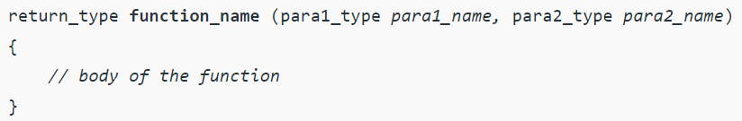
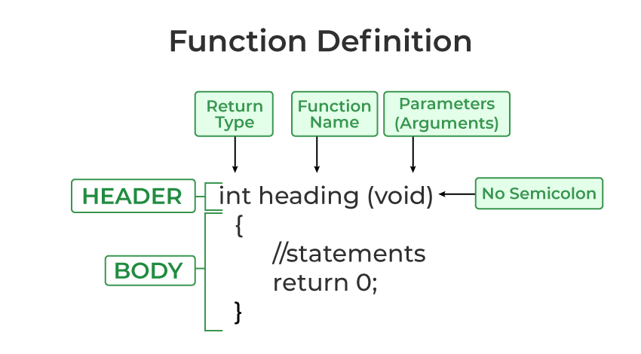
Function Definition
The function definition consists of actual statements which are executed when the function is called (i.e. when the program control comes to the function).

Slide 9
C Function Declaration and Definition
A function consist of two parts:
Declaration: the function's name, return type, and parameters (if any)
Definition: the body of the function (code to be executed)
void myFunction() { // declaration
// the body of the function (definition)
}
For code optimization, it is recommended to separate the declaration
And the definition of the function.
You will often see C programs that have function declaration above main(), and function
definition below main().
This will make the code better organized and easier to read:

Slide 10
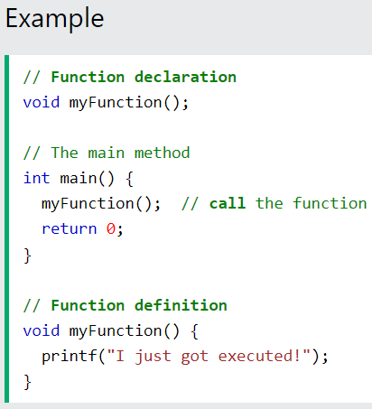
Programming example:
CODE
OUTPUT

Slide 11
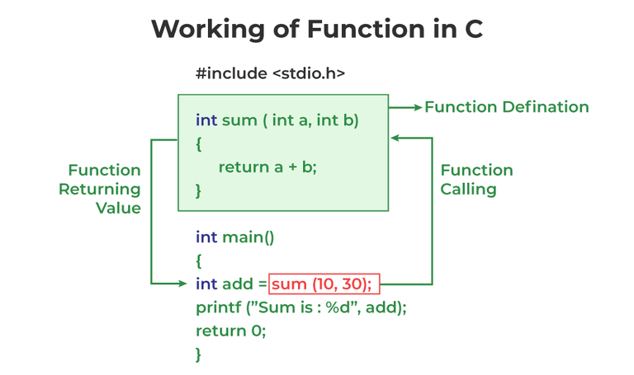
Function Call
A function call is a statement that instructs the compiler to execute the function. We use the function name and parameters in the function call.
Note: Function call is necessary to bring the program control to the function definition. If not called, the function statements will not be executed.

Slide 12
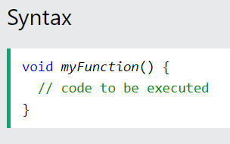
Create a Function
To create (often referred to as declare) your own function, specify the name of the function, followed by parentheses () and curly brackets {}:
myFunction() is the name of the function
void means that the function does not have a return value. You will learn more about return values later in the next topics
Inside the function (the body), add code that defines what the function should do

Slide 13
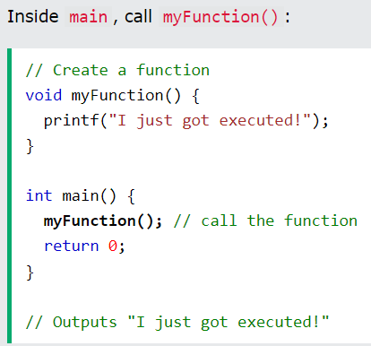
Call a Function
Declared functions are not executed immediately. They are "saved for later use", and will be executed when they are called.
To call a function, write the function's name followed by two parentheses () and a semicolon ;
In the following example, myFunction() is used to print a text (the action), when it is called:

Slide 14
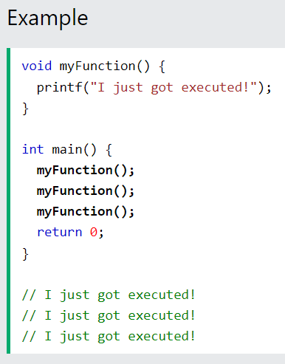
A function can be called multiple times:

Slide 15
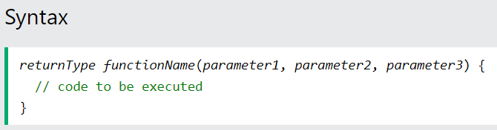
C Function Parameters
Parameters and Arguments
Information can be passed to functions as a parameter. Parameters act as variables inside the function.
Parameters are specified after the function name, inside the parentheses. You can add as many parameters as you want, just separate them with a comma:
A parameter is a variable that we use in a function definition. (Formal parameters)
An argument is the actual data that we pass to the function parameter.(Actual Paramaters)

Slide 16
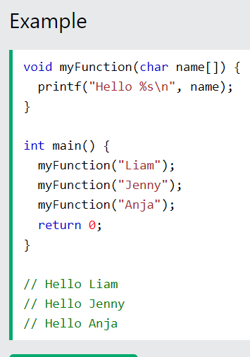
The following function that takes a string of characters with name as parameter. When the function is called, we pass along a name, which is used inside the function to print "Hello" and the name of each person.

Slide 17
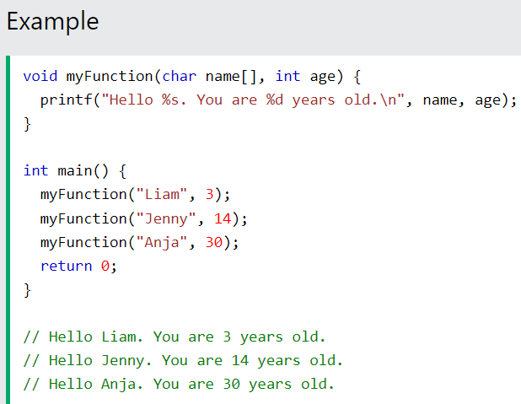
Multiple Parameters
Inside the function, you can add as many parameters as you want:

Slide 18
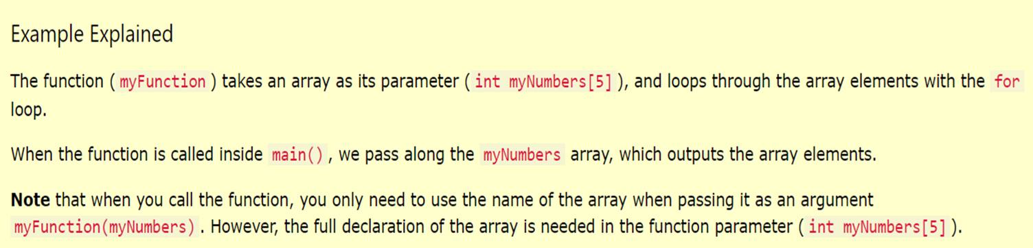
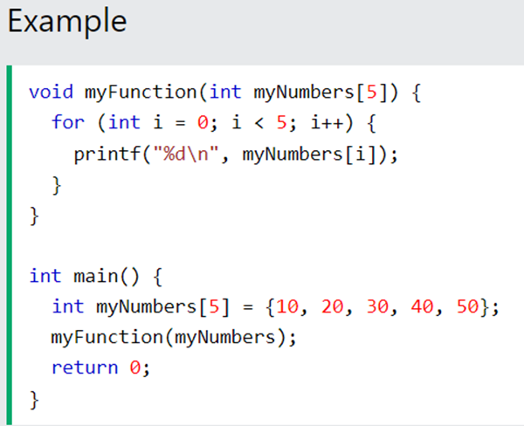
Pass Arrays as Function Parameters
You can also pass arrays to a function:

Slide 19
Passing arrays as function parameters
When we want to pass an array to a function, it is always passed by giving the name of the array, which is nothing but the start address of the array.
int slen(char s[])
{
int i=0,len=0;
while(s[i++] != '\0') {
len++;
}
return(len);
}
int main()
{
char s1[]="hello123";
int len;
len = slen(s1); /* Specify the name of the array as the argument to slen() */
printf("len=%d\n",len);
}

Slide 20
Equivalence between array and pointer
int slen(char *s) /* Declaring the format parameter as a char pointer */
{
int i=0,len=0;
while(*s++ != '\0') {
len++;
}
return(len);
}
int main()
{
char s1[]="hello123";
int len;
len = slen(s1); /* Specify the name of the array as the argument to slen() */
printf("len=%d\n",len);
}

Slide 21
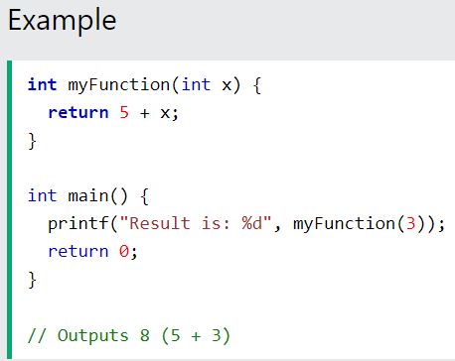
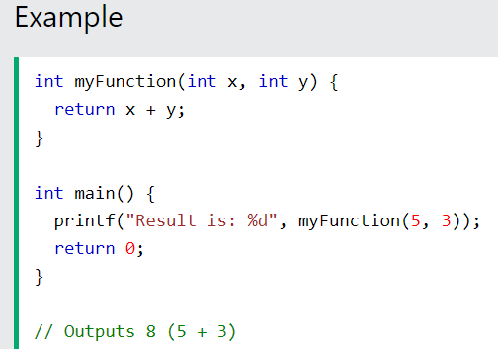
Return Values
The void keyword, used in the previous examples, indicates that the function should not return a value.
If you want the function to return a value, you can use a data type (such as int or float, etc.) instead of void, and use the return keyword inside the function:
This example returns the sum of a function with two parameters:

Slide 22
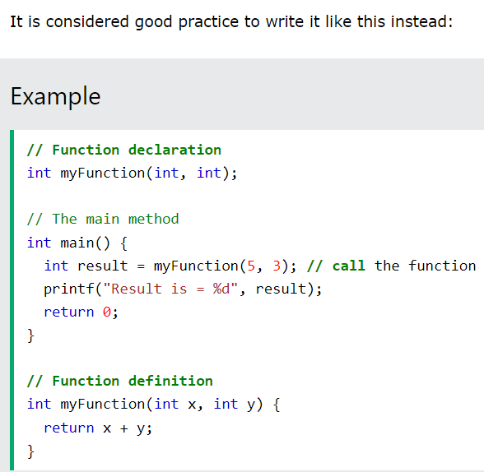
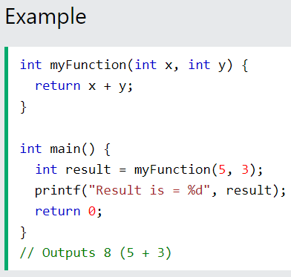
You can also store the result in a variable:

Slide 23
Function categories
There are 4 types of functions:
1. Functions without arguments and without return values
2. Functions without arguments and with return values
3. Functions with arguments and without return values
4. Functions with arguments and return values

Slide 24
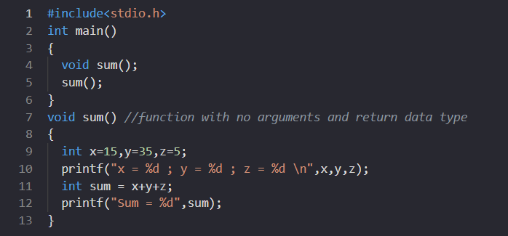
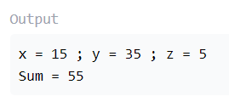
Functions without arguments and without return values

Slide 25
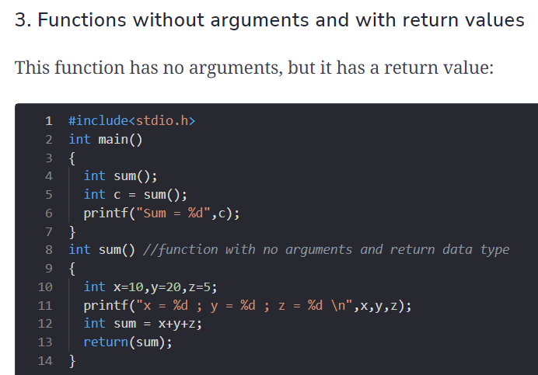
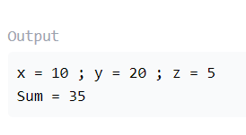
Functions without arguments and with return values

Slide 26
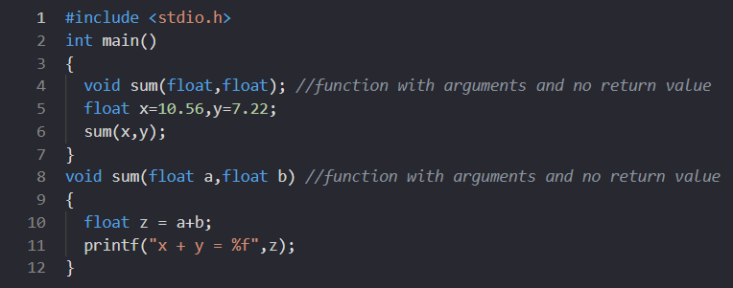
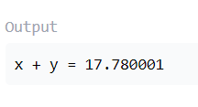
Functions with arguments and without return values

Slide 27
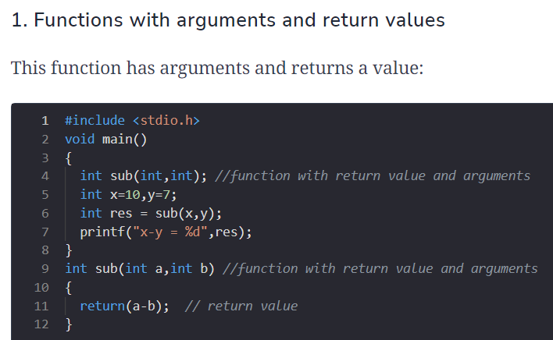
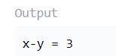
Functions with arguments and return values

Slide 28
Difference between the Call by Value and Call by Reference
Call By Value
While calling a function, we pass the values of variables to it. Such functions are known as “Call By Values”.
The value of each variable in the calling function is copied into corresponding dummy variables of the called function.
The changes made to the dummy variables in the called function have no effect on the values of actual variables in the calling function.
In call-by-values, we cannot alter the values of actual variables through function calls.
Values of variables are passed by the Simple technique.
This method is preferred when we have to pass some small values that should not change.
Call By Reference
While calling a function, instead of passing the values of variables, we pass the address of variables(location of variables) to the function known as “Call By References.
The address of actual variables in the calling function is copied into the dummy variables of the called function.
Using addresses we would have access to the actual variables and hence we would be able to manipulate them.
In call by reference, we can alter the values of variables through function calls.
Pointer variables are necessary to define to store the address values of variables.
This method is preferred when we have to pass a large amount of data to the function.

Slide 29
Pointers as function arguments
Passing the pointers to the function means the memory location of the variables is passed to the parameters in the function, and then the operations are performed.
The function definition accepts these addresses using pointers, addresses are stored using pointers.
Arguments Passing without pointer
When we pass arguments without pointers the changes made by the function would be done to the local variables of the function.

Slide 30
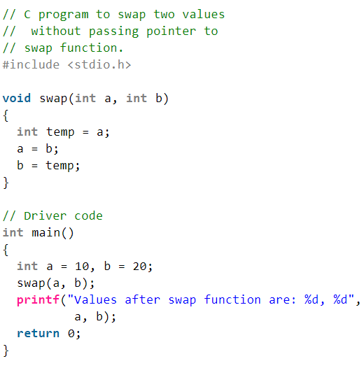
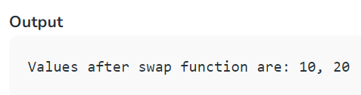
Pointers as function arguments

Slide 31
Arguments Passing with pointers
A pointer to a function is passed in this example. As an argument, a pointer is passed instead of a variable and its address is passed instead of its value.
As a result, any change made by the function using the pointer is permanently stored at the address of the passed variable.
In C, this is referred to as call by reference.

Slide 32
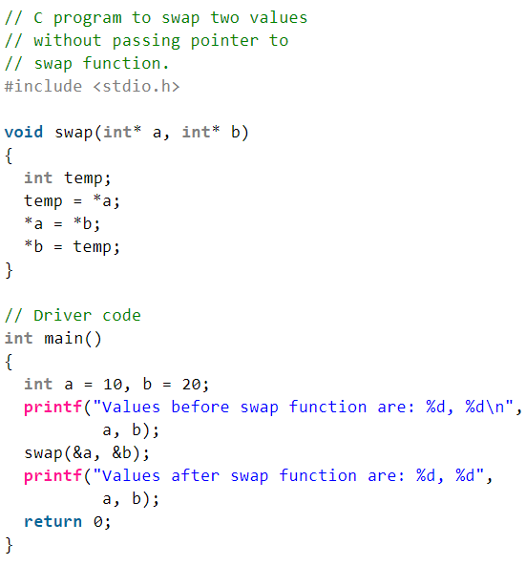
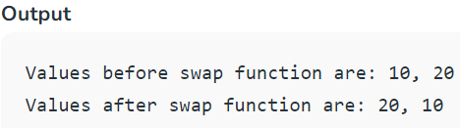
Arguments Passing with pointers

Slide 33
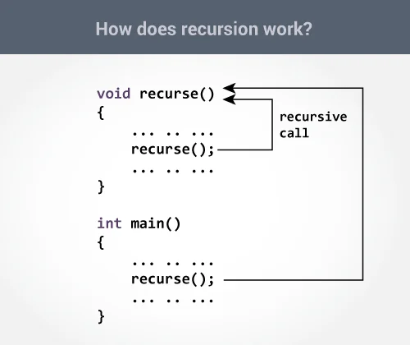
Recursion
A function that calls itself is known as a recursive function. And, this technique is known as recursion.
The recursion continues until some condition is met to prevent it.
To prevent infinite recursion, if...else statement (or similar approach) can be used where one branch makes the recursive call, and other doesn't.

Slide 34
Advantages and Disadvantages of Recursion
Recursion makes program elegant. However, if performance is vital, use loops instead as recursion is usually much slower.
That being said, recursion is an important concept. It is frequently used in data structure and algorithms.
For example, it is common to use recursion in problems such as tree traversal.

Slide 35
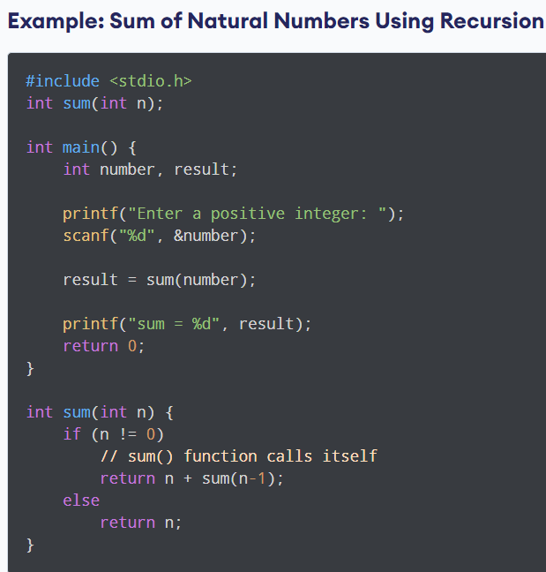
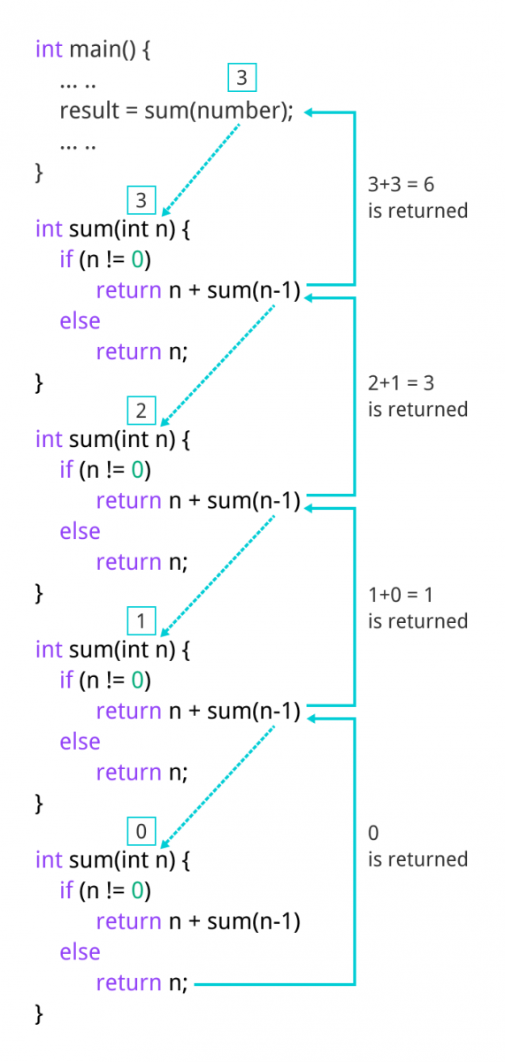
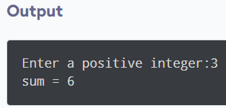

Slide 36
Calculation of Factorial
Factorial of ‘n’ is given by
n! = 1*2*3*…….*(n-2)*(n-1)*n.
This can also be written as:
n! = (1*2*3…….*(n-2)*(n-1)) * n
n! = (n-1)! * n
Such a description lends itself naturally to a recursive implementation. Suppose we want to write a function to calculate factorial of ‘n’ which is the parameter, it can actually call itself with parameter (n-1), and multiply the returned value with ‘n’ to get the result.

Slide 37
Factorial – Recursive implementation
int fact(int n)
{
if (n == 1)
return 1;
else
return(n * fact(n-1)); /* Recursive call */
}
int main()
{
int x;
scanf(“%d”,&x);
printf(“Factorial of %d = %d \n”,x,fact(x));
}

Slide 38
Find the Output
What will be the output of this Code Snipet.
#include <stdio.h>
void func() {
static int x = 0;
x++;
printf("%d ", x);
}
int main() {
func();
func();
func();
return 0;
}

Slide 39
MCQs
What is the default return types of a function ?
void
int
char
boolean
Which of the following is a correct function declaration?
void func(int a);
func void(int a);
int func(a int);
None of the above

Slide 40
What is the scope of a variable declared inside a function?
Global
Local
Static
None of the above
Which of the following is a valid way to pass arguments to a function in C?
Pass by value
Pass by reference
Both a and b
None of the above

Slide 41
EXCERCISE
Write a c program for performing any four arithmetic operations by defining each operations separately in a function.
Write a recursive function to generate fibonacci series.

Slide 42
THANK YOU

